Slide 1

HOUSE PRICE PREDICTION
Project Supervisor: Mr. Murali B.E., M.Tech
Name of the Student: Ms. PANKHURI SANTOSHI
Register Number: 39110740

Slide 2
PRESENTATION OUTLINE
Course Certificate
Introduction
Objectives
System Architecture
Project Implementation
Methodology
Results and Discussions
Conclusion
References

Slide 3
COURSE CERTIFICATE

Slide 4

INTRODUCTION
The aim of this project is to implement the machine learning algorithm with the best accuracy to predict house prices based on features such as super built-up area, number of bedrooms, bathrooms as well as area.
Machine learning (ML) is a type of artificial intelligence (AI) that allows software applications to become more accurate at predicting outcomes without being explicitly programmed to do so. Machine learning algorithms use historical data as input to predict new output values. Recommendation engines are a common use case for machine learning. Other popular uses include fraud detection, spam filtering, malware threat detection, business process automation (BPA) and Predictive maintenance.
Investment is a business activity that most people are interested in this globalization era. There are several objects that are often used for investment, for example, gold, stocks and property. In particular, property investment has increased significantly since 2011, both on demand and property selling. One of the increasing of property demand is because of high population in India. Indian Central Bureau of Statistics states that in North India, 50% of the population is classified as a young population who have age approximately at 30 years old.

Slide 5
OBJECTIVES
This objective of this project is to develop a project which predicts the price of a house on basis of attributes such as area, number of bedrooms, bathrooms and location.
Recent statistics has house that the demand of houses in the succeeding years are increasing at an alarming rate. The reason for this van be increased life expectancies or children leaving house at a young age etc.
Its proven that when going to buy a house having a set budget not only helps one to find he perfect house with all required amenities, but also enables us to choose the perfect properties .
This project enables user to have a median amount which is required to buya housed with desired attributes.

Slide 6
IDEATION MAP

Slide 7
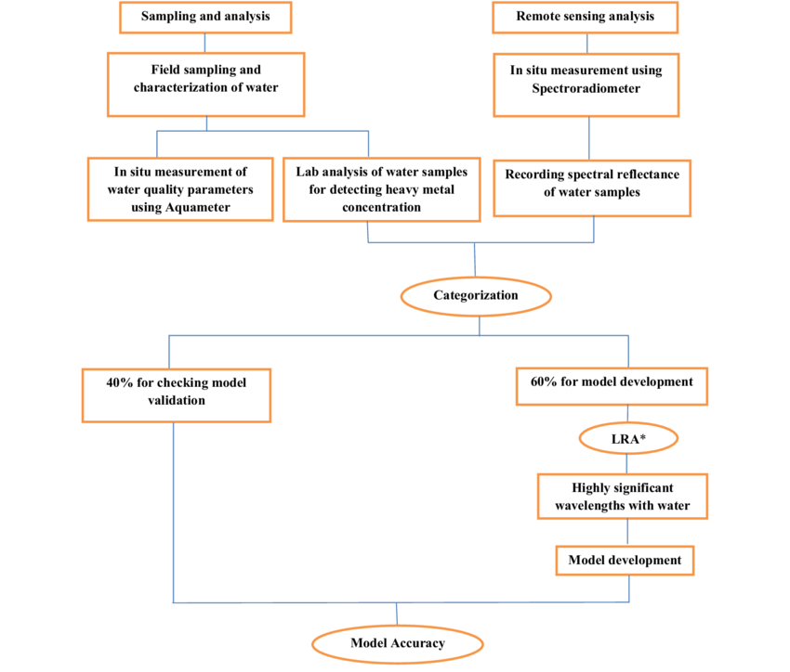

Slide 8
PROJECT IMPLEMENTATION
Machine learning (ML) is the study of computer algorithms that can improve automatically through experience and by the use of data. It is seen as a part of artificial intelligence. Machine learning algorithms build a model based on sample data, known as training data, in order to make predictions or decisions without being explicitly programmed to do so. Machine learning algorithms are used in a wide variety of applications, such as in medicine, email filtering, speech recognition, and computer vision, where it is difficult or unfeasible to develop conventional algorithms to perform the needed tasks.
7 Steps of machine learning:
Collecting Data:
Preparing the Data:
Choosing a Model:
Training the Model:
Evaluating the Model:
Parameter Tuning:
Making Predictions:

Slide 9
METHODOLOGY
Linear Regression is a machine learning algorithm based on supervised learning. It performs regression task. Regression models a target prediction value based on independent variables. It is mostly used for finding out the relationship between variables and forecasting. Different regression models differ based on – the kind of relationship between dependent and independent variables they are considering, and the number of independent variables getting used.
Linear regression performs the task to predict a dependent variable value (y) based on a given independent variable (x). So, this regression technique finds out a linear relationship between x (input) and y(output). Hence, the name is Linear Regression.
Y= a0+a1X+ ε, where
Y = Dependent Variable X = Independent Variable
a0 = Intercept of the line that offers additional DOF or degree of freedom.
a1 = Linear regression coefficient, which is a scale factor to every input value.
ε = Random error

Slide 10
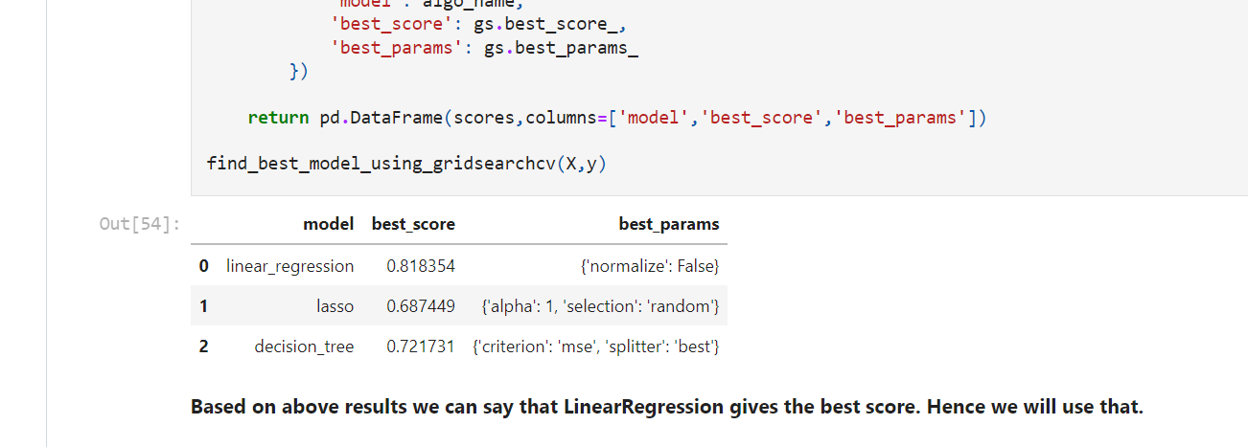
We had implemented 3 models, linear regression, lasso and decision tree. Upon whose results GridsearchCV was deployed to find the model with best accuracy wherein linear regression emerged as the winner.

Slide 11
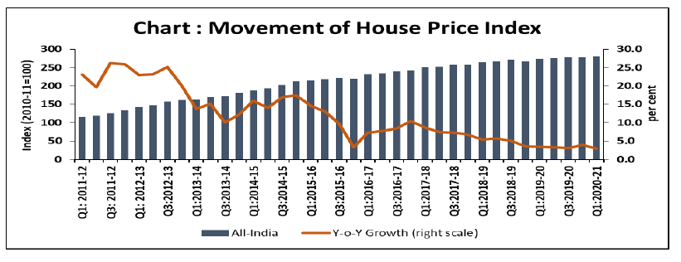
RESULTS AND DISCUSSION
Linear Regression was decided to be implemented in project because it had the highest accuracy.
The user was able to get the median range of the house at desired location
The user was also able to adjust his needs and also broker the best home loan plan according to the results.
Link to the Project:
https://github.com/pankhuri2910/House-price-prediction

Slide 12
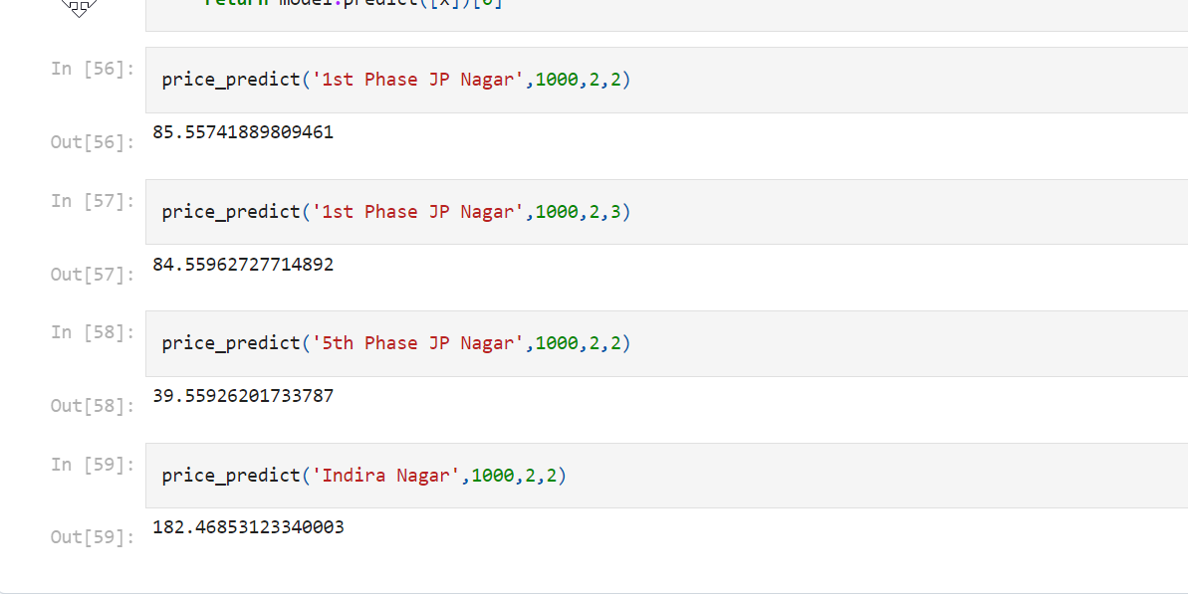
SCREENSHOT

Slide 13
CONCLUSION
Improvement in computing technology has made it possible to examine social information that cannot previously be captured, processed and analyzed. New analytical techniques of machine learning can be used in property research. This study is an exploratory attempt to use three machine learning algorithms in estimating housing prices, and then compare their result.
First, our study has shown that advanced machine learning algorithms like Decision tree, linear regression and lasso, are promising tools for property researchers to use in housing price predictions. However, we must be cautious that these machine learning tools also have their own limitations. There are often many potential features for researchers to choose and include in the models so that a very careful feature selection is essential.
To conclude, the application of machine learning in property research is still at an early stage. We hope this study has moved a small step ahead in providing some methodological and empirical contributions to property appraisal, and presenting an alternative approach to the valuation of housing prices. Future direction of research may consider incorporating additional property transaction data from a larger geographical location with more features, or analysing other property types beyond housing development.

Slide 14

REFERENCE
1. https://www.kaggle.com/datasets/amitabhajoy/bengaluru-house-price-data
2. https://towardsdatascience.com/predicting-house-prices-with-linearregression-
machine-learning-from-scratch-part-ii-47a0238aeac1
3. https://github.com/
4. https://www.wikipedia.org
5. https://www.javatpoint.com
6. https://www.geeksforgeeks.org
7. https://www.tutorialspoint.com
8. https://www.wikihow.com
9. https://stackoverflow.com
10. https://www.w3schools.com

